Slide 1
Walk in my shoes

Slide 2
[To add intro imagery]
[audio narration by Jac]

Slide 3
In this module
Who I am - empathy map
What’s my story - narrative canvas
Stories that I’m proud of
Stories that I learned a lot from
Stories that really hurt
Notes:
Consider timelines later

Slide 4
Who I am

Slide 5
[To add paragraph of content on identity]

Slide 6
[To add paragraph of content on empathy mapping]

Slide 7
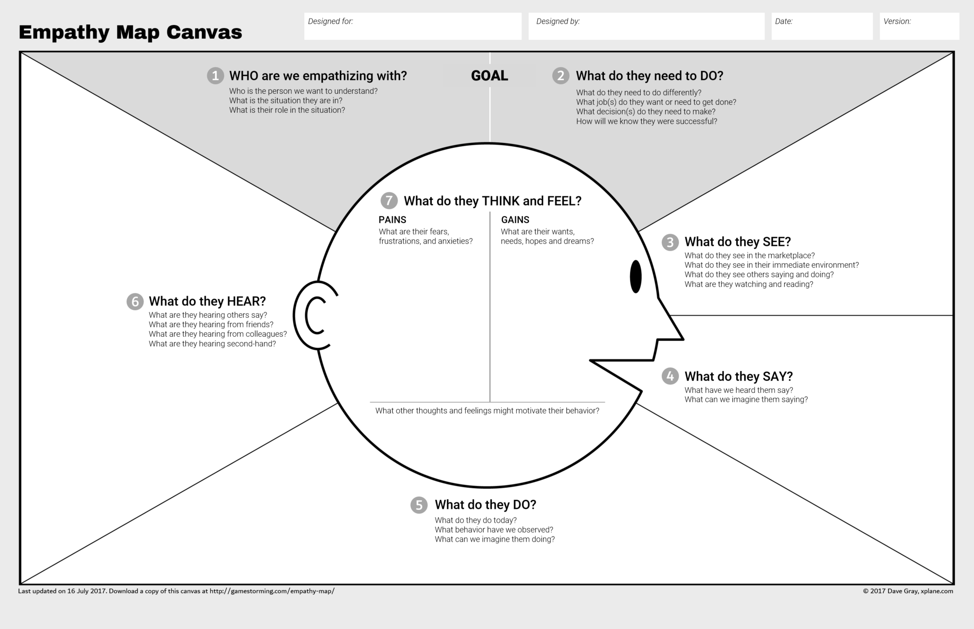
Printable Worksheet
Notes:
[Worksheet one] - should bre printable on A3

Slide 8
Share back
Capture a reflection of what you learned from the last exercise
Notes:
[If we can add a survey or journal into our program content, I’d like to capture their learnings throughout the course content]

Slide 9
2. What’s my story?

Slide 10
[To add content on narrative]

Slide 11
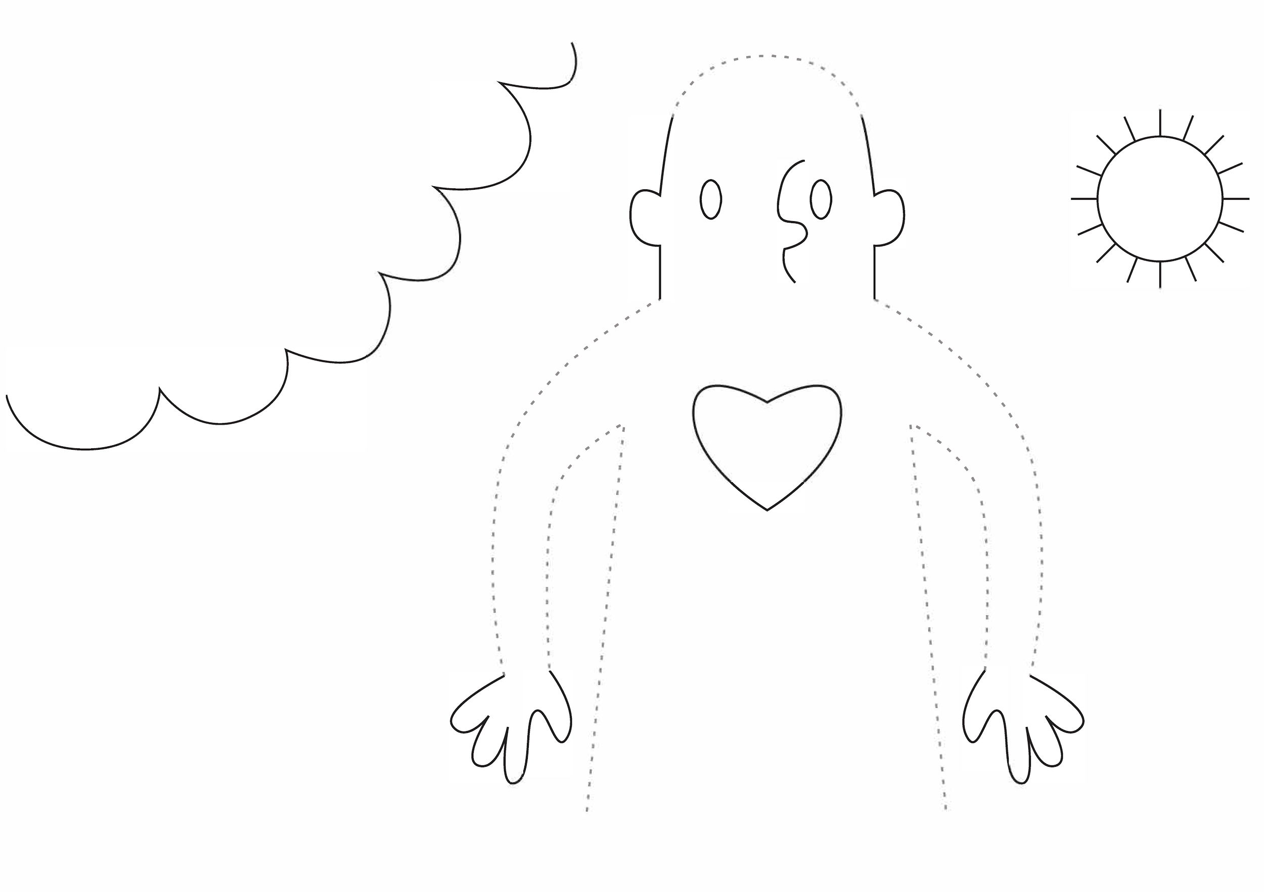
MY STORY
POSITIVES
Good things in life
3 WORDS
That describe how I see my life
NEGATIVES
Worries or stresses
Printable Worksheet
WHO I AM
HEADACHES
Pain points that are really bothering me
NEEDS
Things I need to be my best
MY ROLES
WHO’S IN MY PICTURE
WHAT BRINGS YOU HERE?
Purpose. Why are you here?
GOALS & MOTIVATIONS
Desired outcome. What I want to achieve?
Notes:
Story Canvas [Worksheet 2] - should bre printable on A3

Slide 12
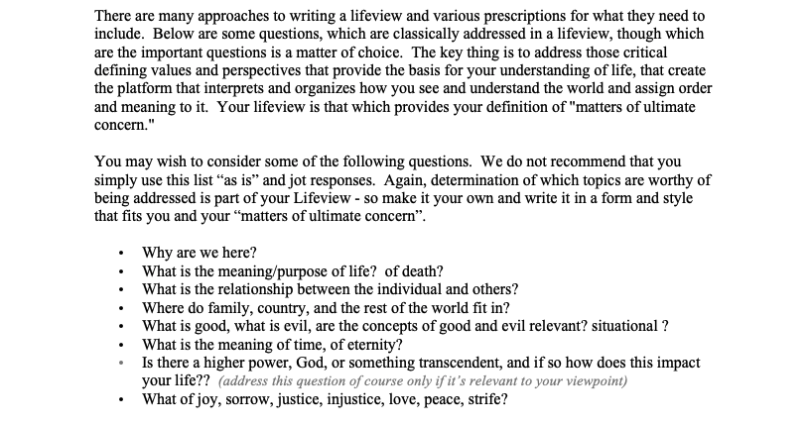
Lifeview reflection worksheet
Printable Worksheet
Notes:
Worksheet 3
Lifeview

Slide 13
3. I am here

Slide 14
[content for Balance dashboard]

Slide 15
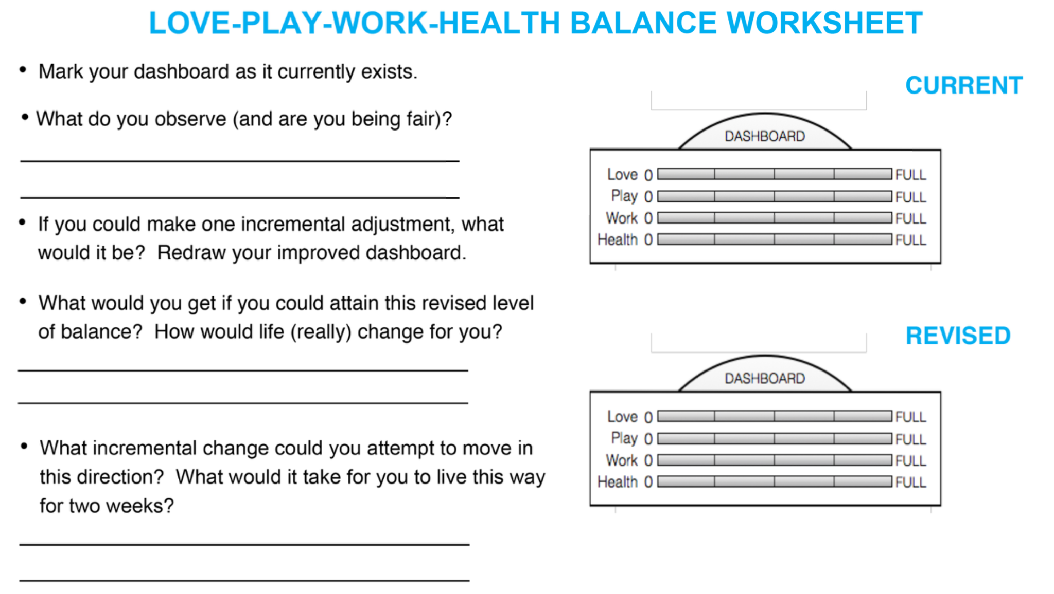
Printable Worksheet

Slide 16
How has being a mother changed who I am?

Slide 17
Matrescence is both oppressive and liberating in nature. It is an experience of disorientation and reorientation marked by an acceleration of changes in multiple domains: physical (changes in the body, hormonal fluctuations); psychological (e.g., identity, personality, defensive structure, self-esteem); social (e.g., re-evaluation of friendships, the forgiveness of loved ones, gains in social status, or loss of professional status), and spiritual (e.g., existential questioning, re-commitment to faith, increased religious/spiritual practices).
Dr Aurelie Athan

Slide 18
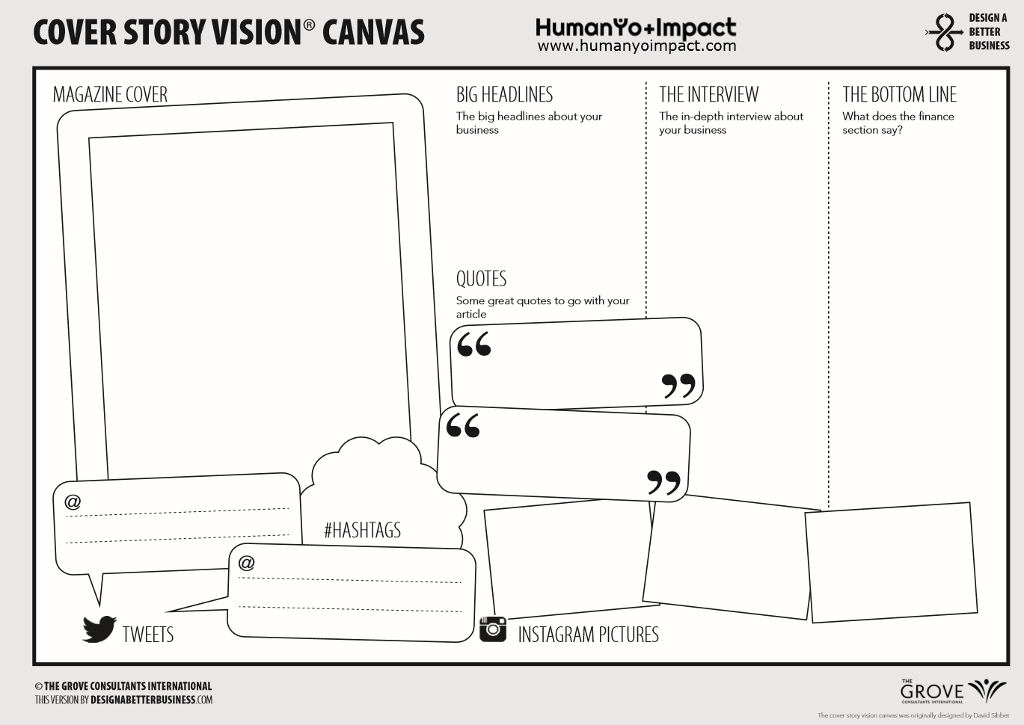

Mama: What’s your story then?
Printable Worksheet
Events
Roles & Responsibilities
Results
Notes:
Worksheet 4
Mama Headlines
To be re-created more personally

Slide 19
[Share back point]
screenshot

Slide 20
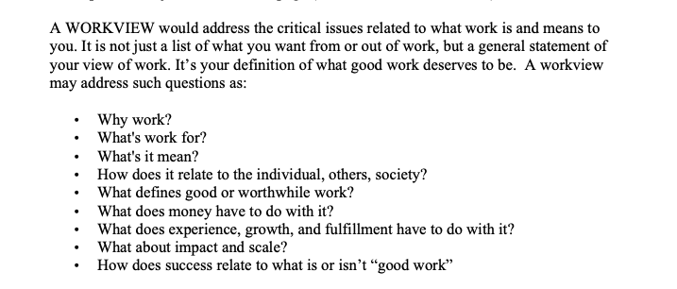
Workview reflection
Printable Worksheet
Notes:
Worksheet 5
Workview reflection

Slide 21
Colleague, employee, manager, business owner: What’s your story?
Printable Worksheet
Events
Roles & Responsibilities
Results
Notes:
Worksheet 5
Workview headlines

Slide 22
Journal
What thoughts and beliefs sit behind this story?
What ideas, insights or questions pop up for you after writing these personal views?
Where might your narrative come from? Why do believe this to be true?
Could this narrative be untrue?
Was is easier to write your life view or your work view?
Do these two world views feel coherent?
Notes:
INSIGHT
Worksheet 6
Reflection

Slide 23
What do you want?

Slide 24
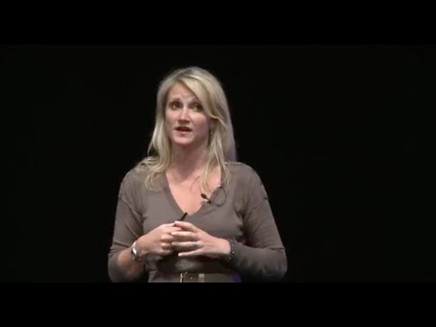
Notes:
1 in 400,000,000,000,000

Slide 25
Everything is fine, right?
Fuck fine
Notes:
This is going to be key to setting the best boundaries for you

Slide 26
…it’s your job to make yourself do the crap that you don’t want to do, so you can be everything you’re supposed to be…and you’re so damn busy waiting to feel like it…
Mel Robbins

Slide 27
Force yourself to get uncomfortable
Mel Robbins
Notes:
Impulse > Activation Energy > Force Yourself / Emergency brake
5 second rule: action the impulse, or the emergency brake gets pulled.

Slide 28
What do you want to move?

Slide 29
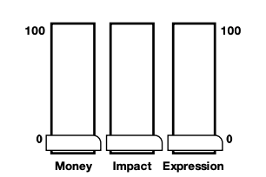
Life gauge
Printable Worksheet

